Slide 1
Sets and Maps

Slide 2
Sets
Set is a data structure that contains a collection of unique elements, and supports insertion of new elements and deletion of the existing ones. Its concept is similar to the mathematical concept of a set.
There are two variations of a set implementation.

Slide 3
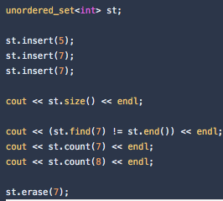
Hash table based set
Hash table based set performs all basic operations in constant O(1) time. In most interview questions, you should use this implementation. Here is how it looks in C++:

Slide 4
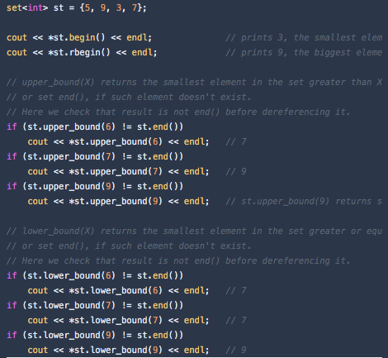
Tree based set
Tree based sets are usually implemented with balanced binary trees, and perform most operations in O(logN) time.
In addition to the basic set operations, they also keep set elements in a sorted order, and support cool operations like these:

Slide 5
Maps
Maps are data structures that contain keys and the values that the keys correspond to.
As with sets, there are two map variations:

Slide 6
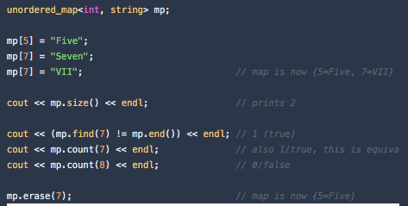
Hash table based map
Hash table based map performs all basic operations in constant O(1) time. In most interview questions, you should use this implementation. Here is how it looks in C++:

Slide 7
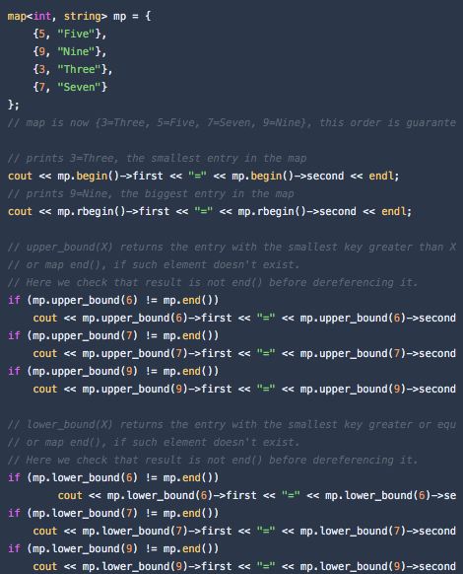
Tree based map
Tree based maps are usually implemented with balanced binary trees, and perform most operations in O(logN) time.
As with tree based sets, they also keep elements in a sorted order (sorted by key), and support cool operations like these:

